Slide 1
BLISS- Blended Learning Implementation for reSilient, acceSsible and efficient higher education
UNIMA – Unit 2 Artificial Neural Networks
Disclaimer: Funded by the European Union. Views and opinions expressed are however those of the author(s) only and do not necessarily reflect those of the European Union or the European Education and Culture Executive Agency (EACEA). Neither the European Union nor EACEA can be held responsible for them.

Slide 2
Agenda
Unit Overview
Constructive Alignment:
ILOs
Schedule & Activity Flow for TAs and ATs
Course Content

Slide 3
Unit Overview
Mother Course: MFE4211 Artificial Intelligence in Engineering (5 ECTS)
Mother Programme: Bachelor in Mechanical Engineering (Year 4)

Slide 4
Unit Overview
Study-unit Aims: To provide an introduction and overview of Artificial Intelligence and its role in Engineering for the development of smart/intelligent systems. This acquired competence will collectively enable students to identify areas in which AI tools and techniques could be applied successfully and create AI programs capable of solving typical engineering problems.

Slide 5
Unit Overview
Course Topic: Artificial Neural Networks
Blended Learning: Online Training Material + In-Class Workshop

Slide 6
Constructive Alignment: ILOs
ILO1 - Explain the basic structure and functions of Artificial Neural Networks.
ILO2 - Apply an Artificial Neural Network to solve a classification problem.
ILO3 - Compare the application of Artificial Neural Networks to the K-Nearest Neighbours Algorithm for a classification problem.

Slide 7
Constructive Alignment: TAs + ATs
Week 1
Week 2
Week 3
Week 3
Part 1
Part 2
Part 3
Part 4
Online Learning and Assessment Content is provided to learn theoretical background about ANNs
TA 1.1, 1.2
AT 1.1, 1.2
In Class Summary of ANNs and how they are applied (e.g. to Vision Systems)
TA 2.1
AT 2.1
In Class Tutorial and Example
TA 2.2
AT 2.2
Online Students work on Case Study and apply their knowledge on ANNs
TA 2.3, 3.1
AT 2.3, 3.1

Slide 8
Part 1
Week 1
Week 2
Week 3
Week 3
Part 1
Part 2
Part 3
Part 4
ILO reference (Highlight the Verb) | Teaching Activity (What the teachers do) | Learning Activity (What the students do)
ILO 1 Explain the basic structure and functions of Artificial Neural Networks | TA 1.1 Explain using an online platform (Moodle) the basic structure of an Artificial Neural Network. TA 1.2 Prepare an online quiz (Moodle) Artificial Neural Networks work. | LA 1.1 Follow the online presentation, take notes (Moodle). LA 1.2 Take an online quiz to test their understanding of ANNs (Moodle).

Slide 9
Part 1
Week 1
Week 2
Week 3
Week 3
Part 1
Part 2
Part 3
Part 4
Supporting Materials:
PowerPoints, SCORM packages and supplementary materials.
A PDF of the online lectures will be provided for reference and future revision.
Online Questionnaire
Supporting equipment: None
Supporting facilities: Online Learning Environment
Instructions:
Students must complete all online materials, including self-assessment questions.
Objective: Ensure students understand the foundational concepts of Artificial Neural Networks

Slide 10
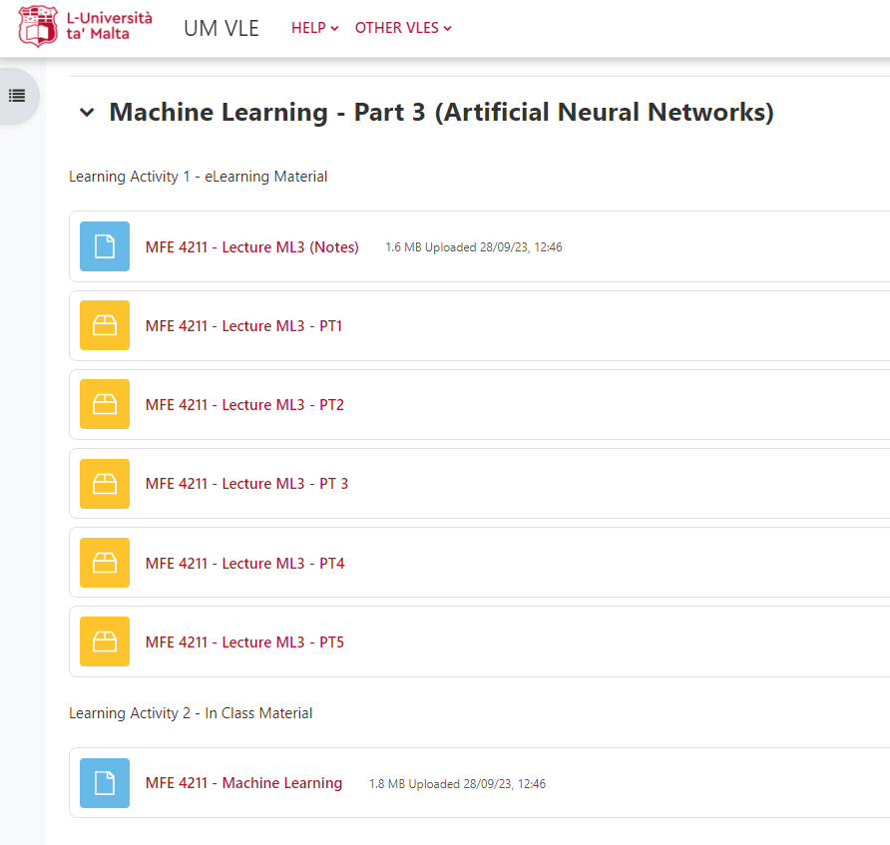
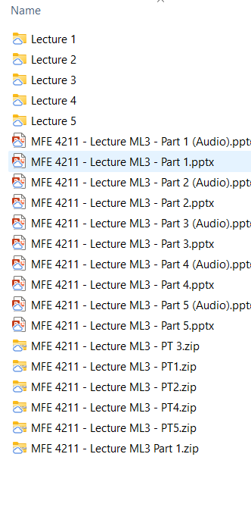
Part 1 - Materials

Slide 11
Part 1 - Materials

Slide 12
Part 1 - Materials

Slide 13
Part 2
Week 1
Week 2
Week 3
Week 3
Part 1
Part 2
Part 3
Part 4
ILO reference (Highlight the Verb) | Teaching Activity (What the teachers do) | Learning Activity (What the students do)
ILO 2 Apply an Artificial Neural Network to solve a classification problem. | TA2.1 Explain and provide a step-by-step presentation and demonstration in person of how ANNs can be applied to solve a problem. | LA 2.1 Listen to presentation, take notes and ask questions. .

Slide 14
Part 2
Week 1
Week 2
Week 3
Week 3
Part 1
Part 2
Part 3
Part 4
Supporting Materials:
Presentation
Supporting equipment: None
Supporting facilities: Lecture Room
Instructions:
Lecturer provides a brief summary of Artificial Neural Networks and other Machine Learning Methods as applied to machine vision applications

Slide 15
Part 2 - Materials

Slide 16
Part 2
Week 1
Week 2
Week 3
Week 3
Part 1
Part 2
Part 3
Part 4
ILO reference (Highlight the Verb) | Teaching Activity (What the teachers do) | Learning Activity (What the students do)
ILO 2 Apply an Artificial Neural Network to solve a classification problem. | TA2.2 Provide a problem and support them in class to apply and implement code to solve this problem. | LA2.2 Apply knowledge about ANNs to implement ANNs and solve a problem with the support of the lecturer.

Slide 17
Part 3
Week 1
Week 2
Week 3
Week 3
Part 1
Part 2
Part 3
Part 4
Supporting Materials:
Tutorial Presentation
Example Code
Supporting equipment: Google Collab
Supporting facilities: Lecture Room with PCs (Computer Lab)
Instructions:
Students will be provided with a case study problem.
Students will work on the problem with the support of lecturer.

Slide 18
Part 3 - Materials

Slide 19
Part 4
Week 1
Week 2
Week 3
Week 3
Part 1
Part 2
Part 3
Part 4
ILO reference (Highlight the Verb) | Teaching Activity (What the teachers do) | Learning Activity (What the students do)
ILO 2 Apply an Artificial Neural Network to solve a classification problem. ILO 3 Compare the application of Artificial Neural Networks to the K-Nearest Neighbours Algorithm for a classification problem. | TA2.3 Provide a new problem statement (online) on how ANNs can be applied to solve a specific problem. TA3,1 Ask students to compare how this problem is formulated differently from when using KNNs (online). | LA2.3 Apply knowledge about ANNs to implement ANNs and solve a problem LA3.2 Compare how tackling this problem using ANNs is formulated differently from when using KNNs.

Slide 20
Part 4
Week 1
Week 2
Week 3
Week 3
Part 1
Part 2
Part 3
Part 4
Supporting Materials:
Case Study Description
Supporting equipment: Google Collab
Supporting facilities: Online learning Environment
Instructions:
Students are provided with a case study problem
Students work on the problem on their own
Students submit their work for assessment via the online portal

Slide 21
Part 4

Slide 22
Unit Overview
1 ECTS
Lecturer Contact Hours:
4 Hours Total
Part 2: 2 Hours
Part 3: 2 Hours
Student Hours:
20 Hours Total
Part 1 Initial Self Study: 4 Hours
Part 4 Work on Case Study: 16 Hours
Total Hours:
24 Hours Total

